Slide 1
Machine learning 101

Slide 2
Plan of the workshop :
What is machine learning ?
What are the types of learning ?
Model examples ?
The machine learning Engineering workflow
Conclusion (Discuss a Hot Topic || propose Study plan | The master algorithm )

Slide 3
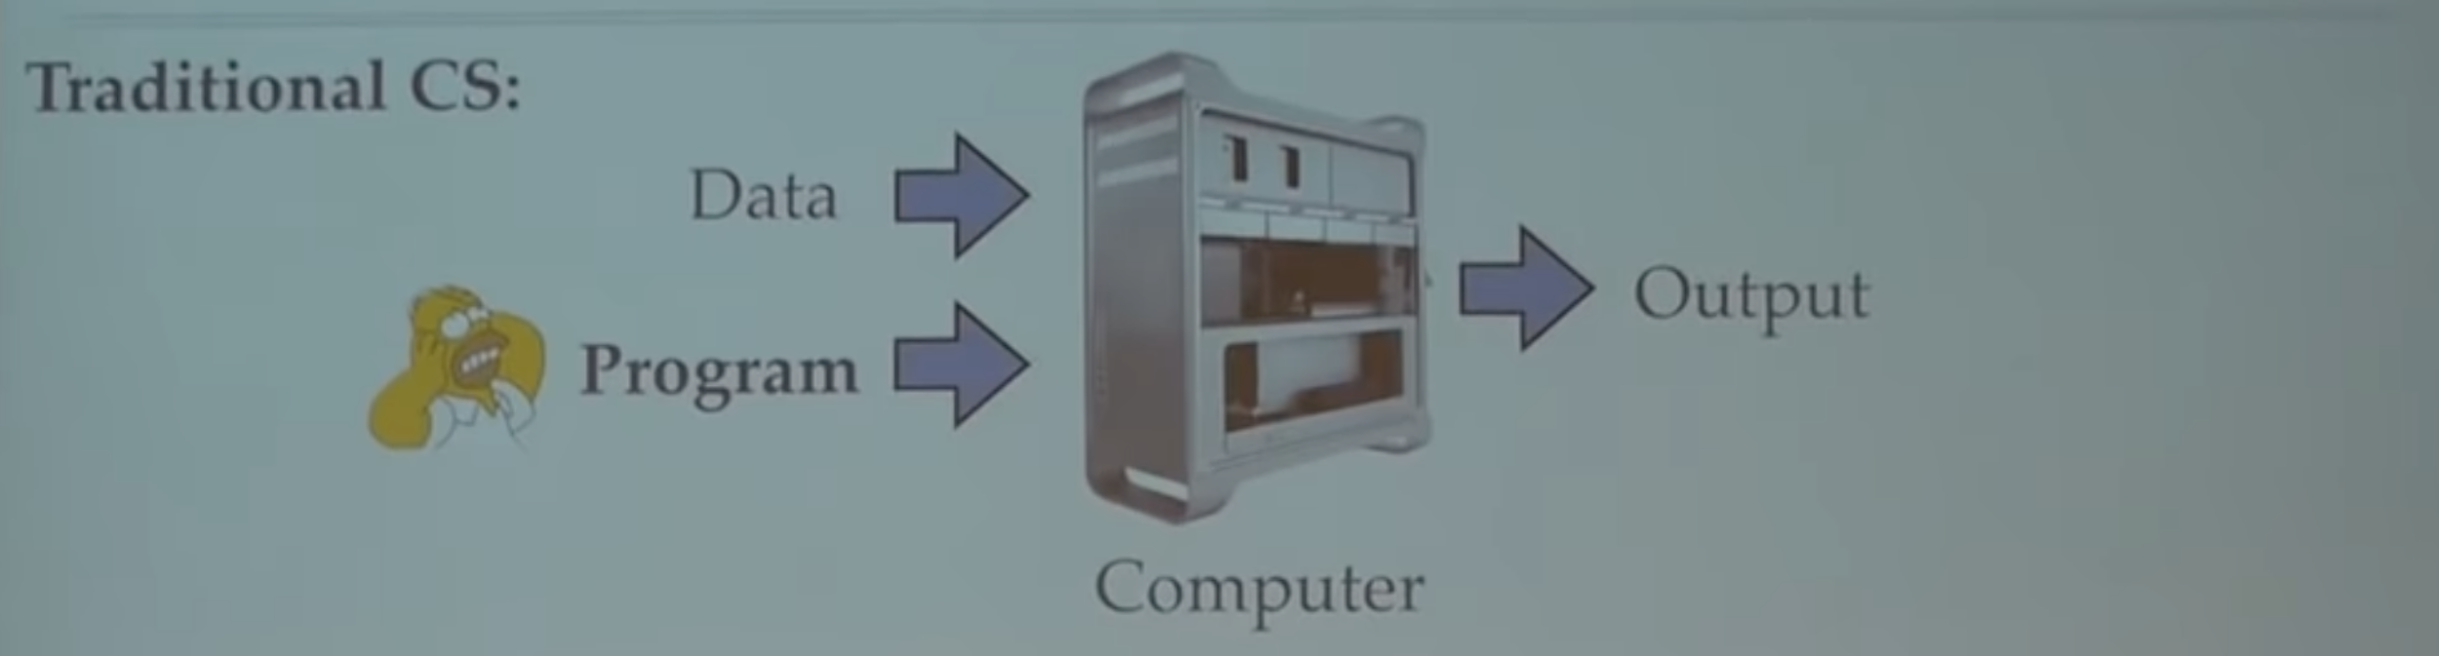
What is machine learning ?
Traditional Computer Science

Slide 4
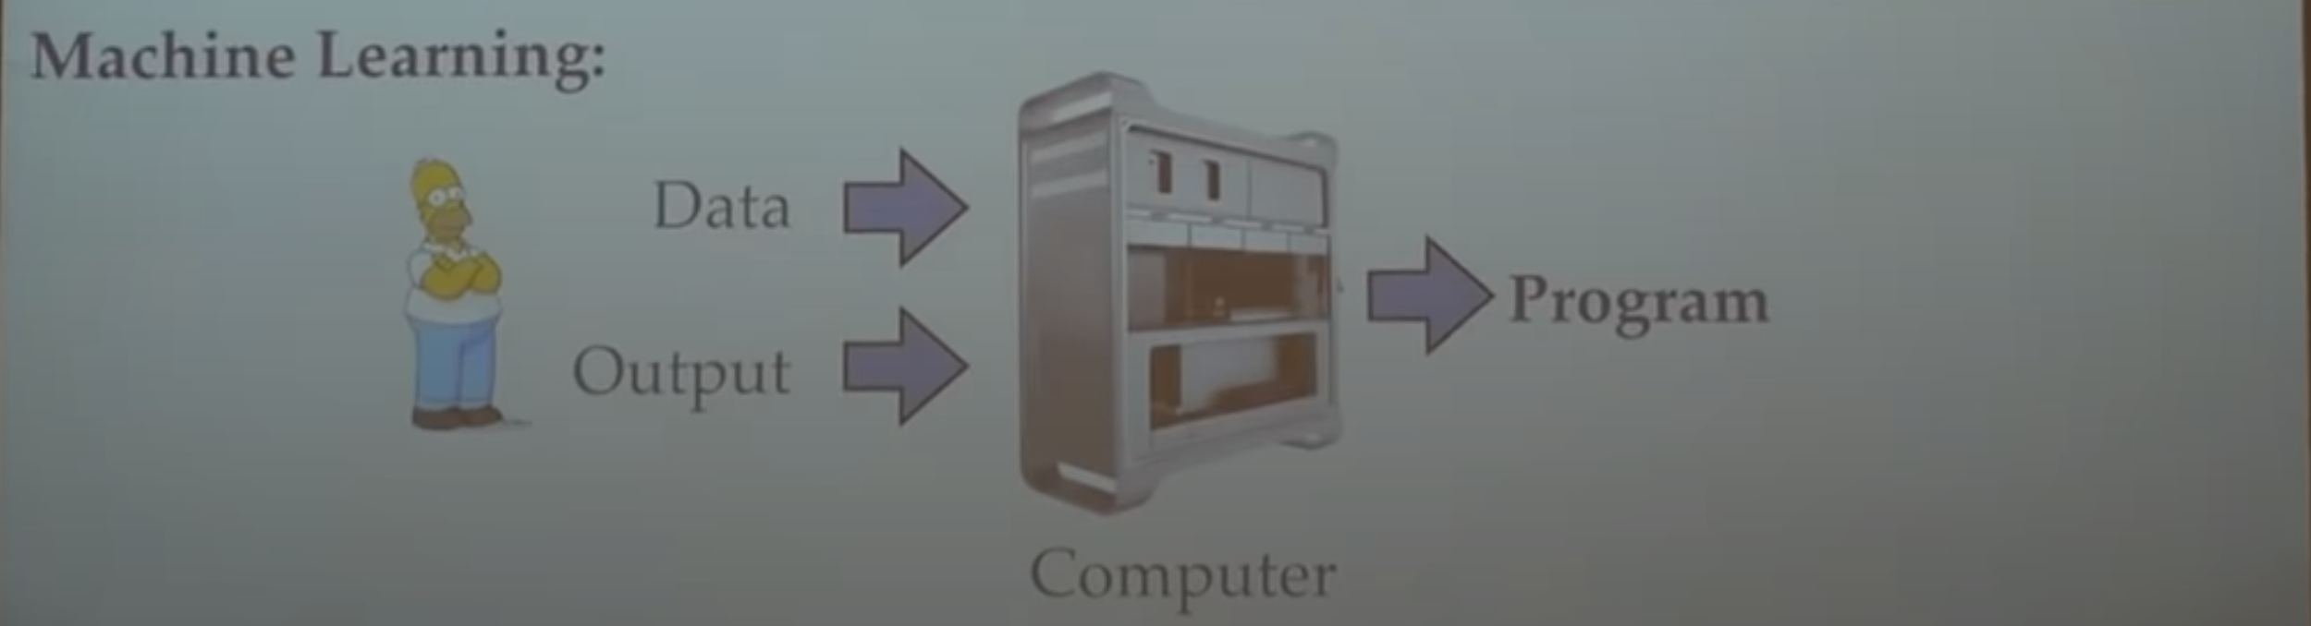
What is machine learning ?
Machine learning

Slide 5
What is machine learning ?
Formally : (Mitchell 1997) A computer program A is said to learn from experience E with respect to some class of tasks T and performance measure P, if it’s performance at the tasks T as measured by P improves with E
Informally : Algorithms that improve on some task with experience

Slide 6
What is machine learning ?
The task T :
Classification
Regression
Machine translation
Structured input
Anomaly detection
Synthesis and sampling
Imputation of missing value
Denoising
The Experience E
Supervised (X,Y)
Regression
Classification
Unsupervised (X)
Reinforcement learning (Model dynamics , Sample Episodes )
The performance P
Accuracy
Loss
Recall

Slide 7
What is machine learning ?
The computer program A (the model)
The main component of every model :
Architecture / Baseline
Loss/objective function
Optimizer
Evaluation Metric
Regulazer

Slide 8
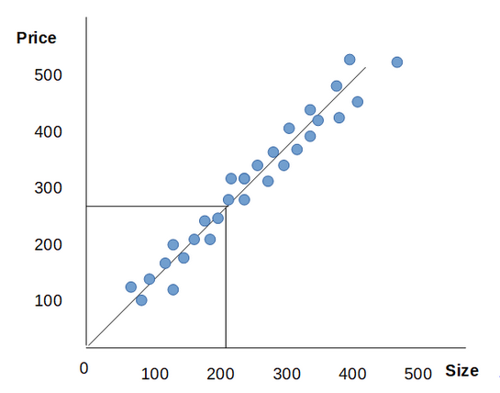
What is machine learning ?
The computer program A (the model)
Housing price prediction Using univariate linear regression
Size | Bedroom | Price *100$
120 | 4 | 400
150 | 3 | 300
200 | 4 | 400
...
300 | 5 | 600

Slide 9
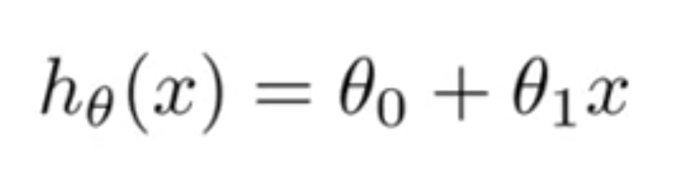
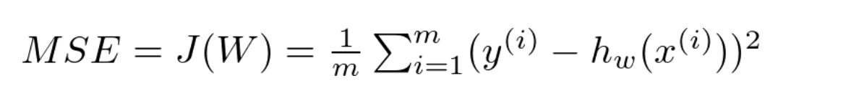
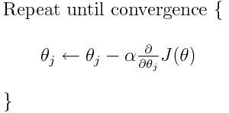
What is machine learning ?
The computer program A (the model)
Housing price prediction Using univariate linear regression
The main component of every model :
Architecture / Baseline :
Loss/objective function : Mean square errors
Optimizer: Gradient Descent
Evaluation Metric: Accuracy
Regulazer: L2 Norm

Slide 10
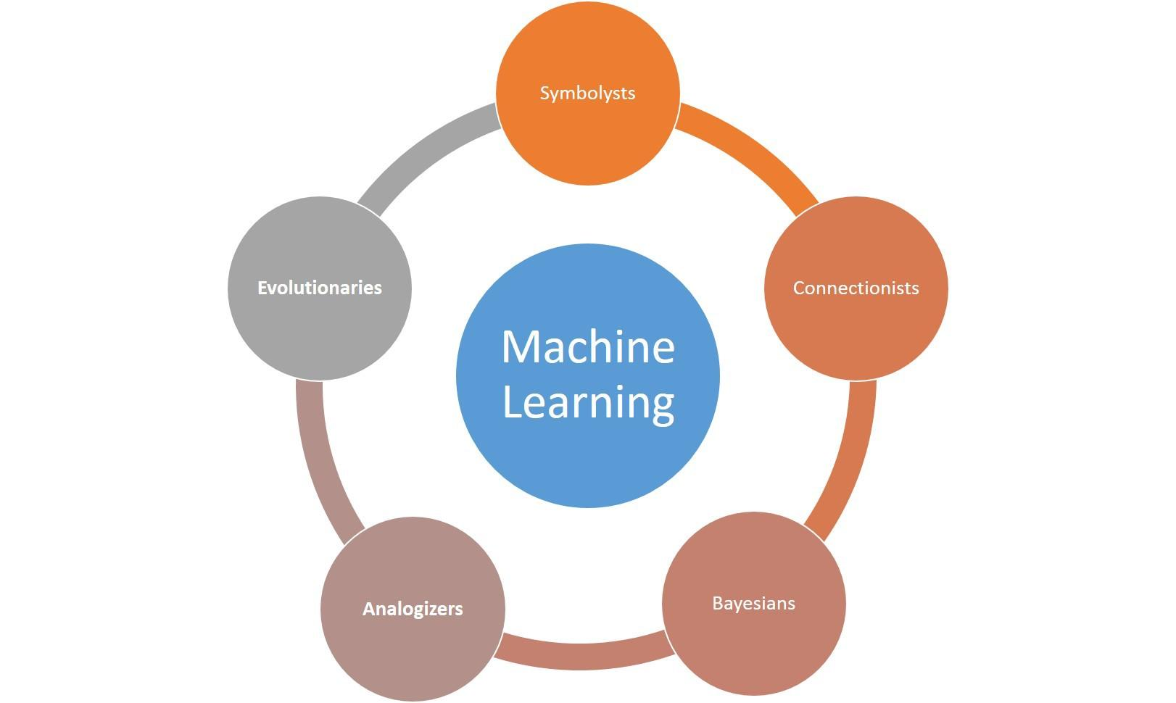
What types of models are there ?
The computer program A (the model)

Slide 11
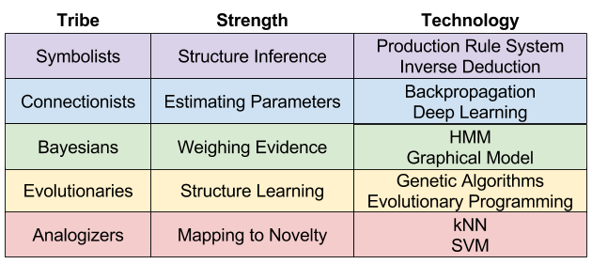
What types of models are there ?

Slide 12
Models examples ?
Connectionist Master Algorithm : Neural Network (Vanila)

Slide 13
Models examples ?
Analogizers Master Algorithm : Support Vector machine
What is a Support vector machine ?
Developed by Rosenblatt at AT&T in 1958
It uses a support vectors to calibrate the dividing hyperplane
Intuition that it hinges on ? and how it differs from other models ?
Non-probabilistic Geometric loss function
Maximizing margins(support vectors) between the classes
What’s the use cases of it ?
Regression and classification and even unsupervised learning
It’s simpler and works better with less data, compared to the amount of data needed for NN
It does not work well on data sets with a lot of noise

Slide 14
Models examples ?
Evolutionaries Master Algorithm : (pick a genetic algorithm)

Slide 15
What is machine learning ?
Bias vs variance tradeoff

Slide 16
Machine learning engineering workflow ?

Slide 17
Recap

